Slide 1
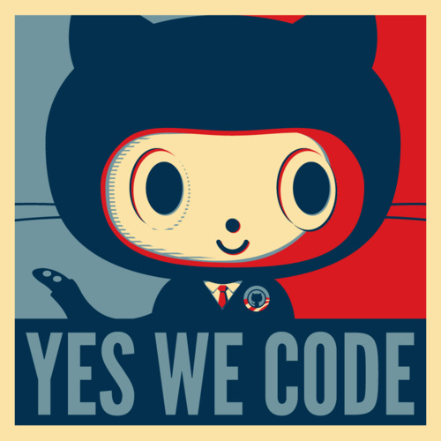
Social coding for fun and profit

Slide 2

So… We have talked about VC
Version control allows you to not only track changes but also to repeal changes and work on multiple branches without breaking the operational base.
Multiple people in your organization can work on the code base and merge your changes together.
Social coding (aka community coding) takes this a step further and opens your code base for solicited and unsolicited OFFERS of contribution.

Slide 3
Platforms
There are two major platforms for social coding:
GitHub: Unlimted free organizations and repos as long as they are open. Private repos = $$$$
BitBucket: Free for projects with up to 5 users but private repos are free (unlimited for academic users). Works with Mercurial as well as Git

Slide 4
The method of contribution: The Pull request.
A rather confusing term… You are actually requesting the project to which you want to contribute to pull code from your branch and merge with one of their branches..
Take home: On GitHub always fork a repo to your account then clone from it.. This allows you to make changes to your repo and put in a PR against the main project.
GitHub has great tools for comparing and commenting code.. Note: As you make changes to the branch you have the PR against the PR is updated.. Thus the project manager can ask for changes and all you need to do is make them in your repo.

Slide 5
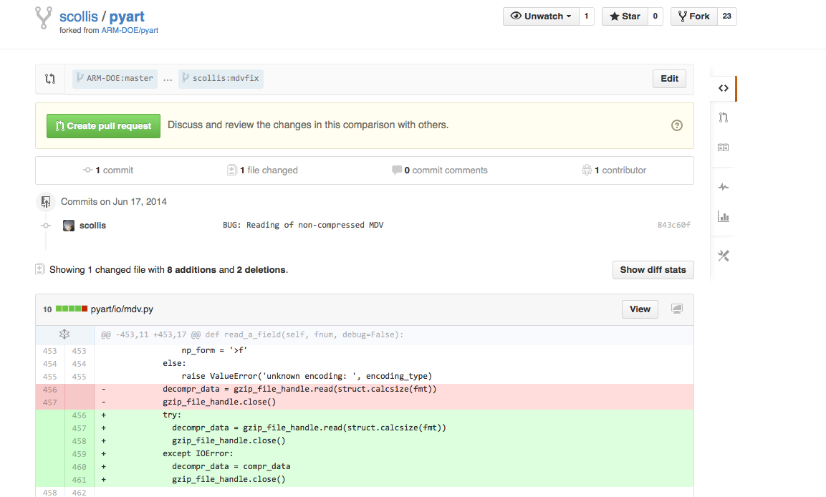
Example

Slide 6
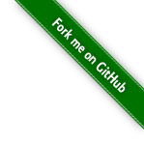

Take home messages
Use version control!
Get your code out there..
It pays dividends!
If you plan to edit code, do not clone the projects repository, create a fork in your own account and work on that..
Us project maintainers love to see our code being forked. ☺

Slide 7
